Slide 1
Procurement Workflow Management System

Slide 2





Group Members
A.H.N.N. Gunawardana
204067U
Group Leader
M.D.S.A. Kularathna
204104H
Member 1
D.A.Y.S. Athukorala
204009V
Member 2
K.G.A.P Dilshan
204041K
Member 3
M.D.K.L. Gunathilaka
204065L
Member 4

Slide 3
Table of contents
Problem in brief
Background of the Project
Aim of the Project
Objectives of the project
Literature Review
Proposed Solution
Analysis and Design
Technologies used
Our approach
Software Process Model
Project Management Plan
Version Control
Evidences of Discussions with the company
Group photo

Slide 4
Problem in brief
The existence of outdated and obsolete systems.
Exploitation of system loopholes by vendors and irresponsible inside staff.

Slide 5
Background of the project
The software is made to replace manual procurement processes which is very problematic and inferior in every way
Introduction of new creative features compared to that make the process more convenient

Slide 6
Aim of the Project
Develop a system to optimize the cost being invested by the organization via a process that involves sourcing, generating requests, placing the order, inspecting the supply received, sending invoices, and journaling the procurement process with the use of the Procurement workflow information management system.

Slide 7
Objectives of the Project
Study the procurement process of the company thoroughly.
Facilitate and Digitize the procurement process.
Allow vendors to maintain relationships with the company through the software.
Design the appropriate system including all user requirements.
Develop the system for solving the problem.

Slide 8
Literature Review
Most popular solutions include software like
SAP Ariba
Coupa
Oracle Procurement Cloud
Procurify
Ivalua
Jaggaer

Slide 9
Proposed Solution
A solution where every step of the procurement process is digitized.
In the system,
The HOD’s will make item requisitions
Items are checked with the company Inventory.
Purchasing Division will make a procurement plan which needs to be approved
Afterwards Vendors are chosen via a bidding process

Slide 10
Proposed Solution
Purchase Orders are created and sent to vendors after being approved
Vendors need to accept purchase orders along with a Bank Guarantee
Goods Received Note is issued after goods have been received
Vendors would send invoices and payments will have to be made
Whenever a step has been completed the party responsible for the next is notified by email/notification

Slide 11
Analysis and Design
List of Diagrams
Use Case Diagram
Class Diagram
Activity DIagram
Sequence Diagram
ER Diagram

Slide 12
Technologies Used
Front End Development
React Js
Bootstrap
Backend Development
.NET
ASP.NET
Database
MS SQL
UI/UX Figma

Slide 13
Our Approach
The software process model that we used to define and organize the activities and tasks involved in the development of our project is discussed together with the users, inputs, and outputs of the system.

Slide 14
Software Process Model
Waterfall Model chosen
Requirements are clear
Tight deadlines
Done step by step
Hard to communicate with client all the time

Slide 15
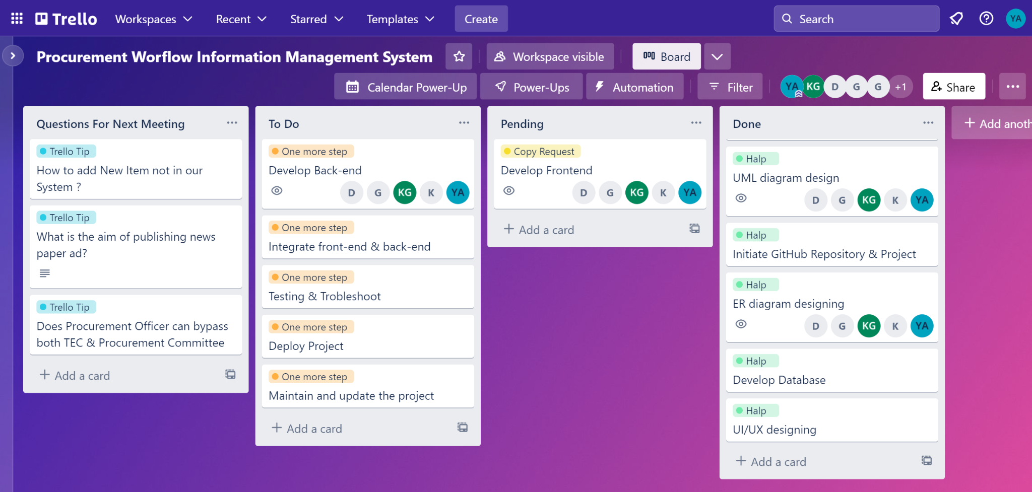
Project Management Plan

Slide 16
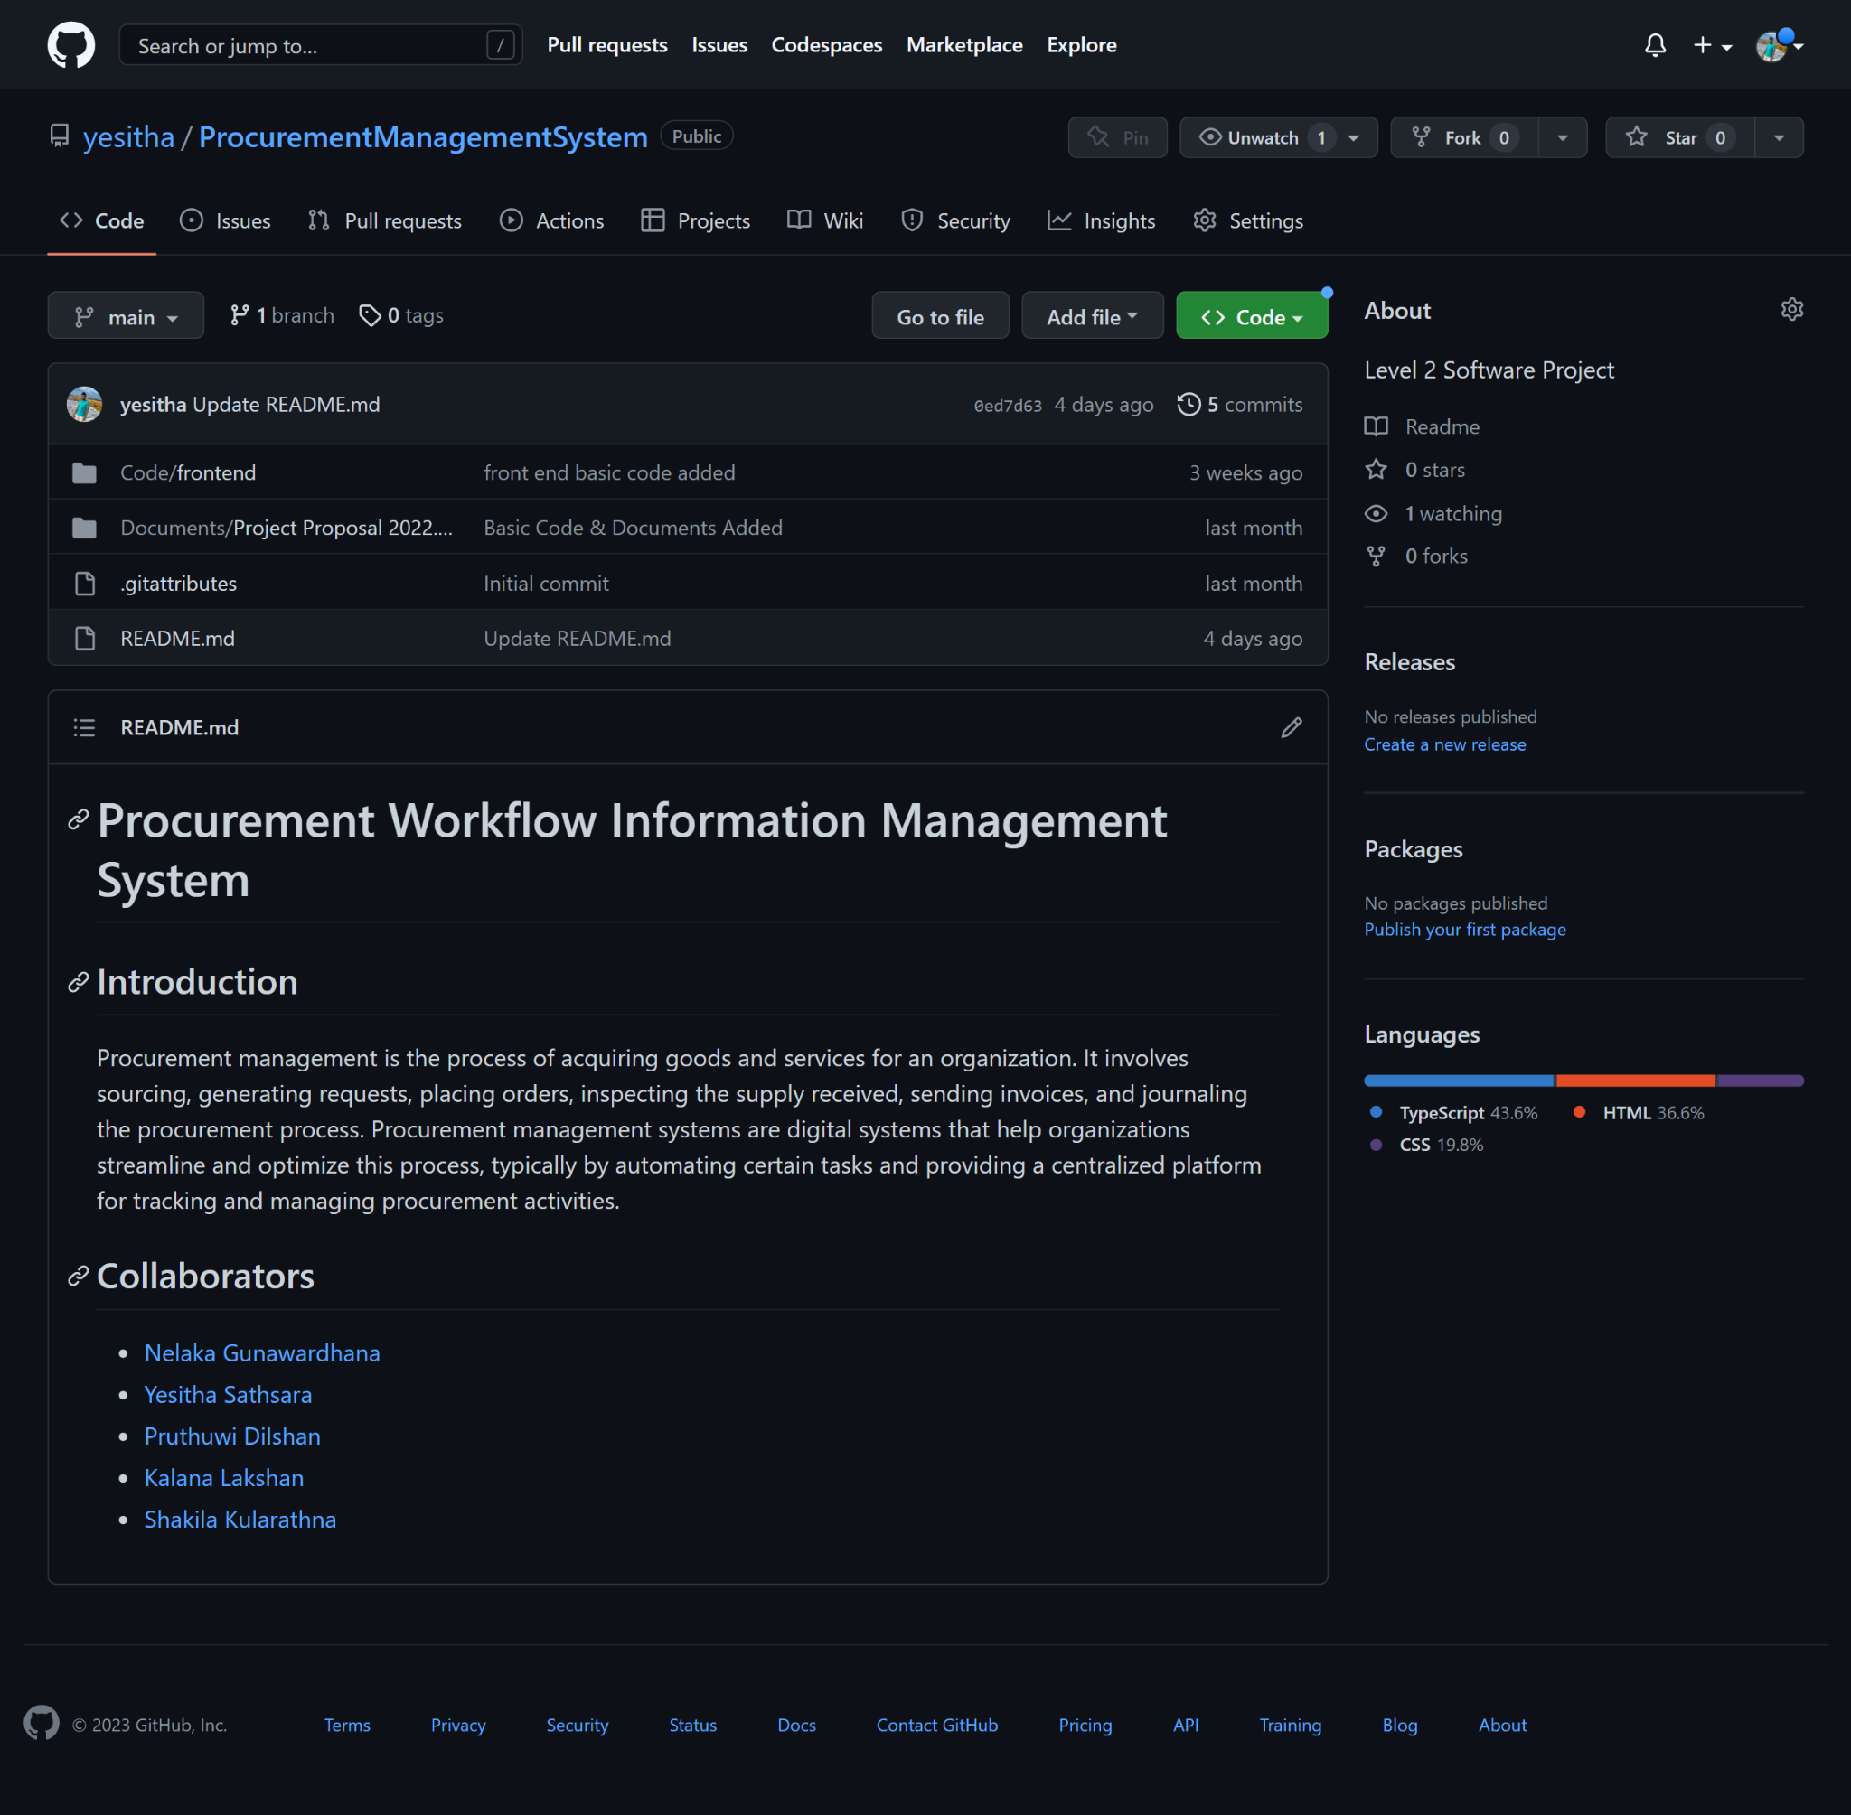
Version Control

Slide 17
Further Work
Ability to create reports within the software
Ability to use the software universally

Slide 18
Individual Contribution
*This slide will display a video clip

Slide 19
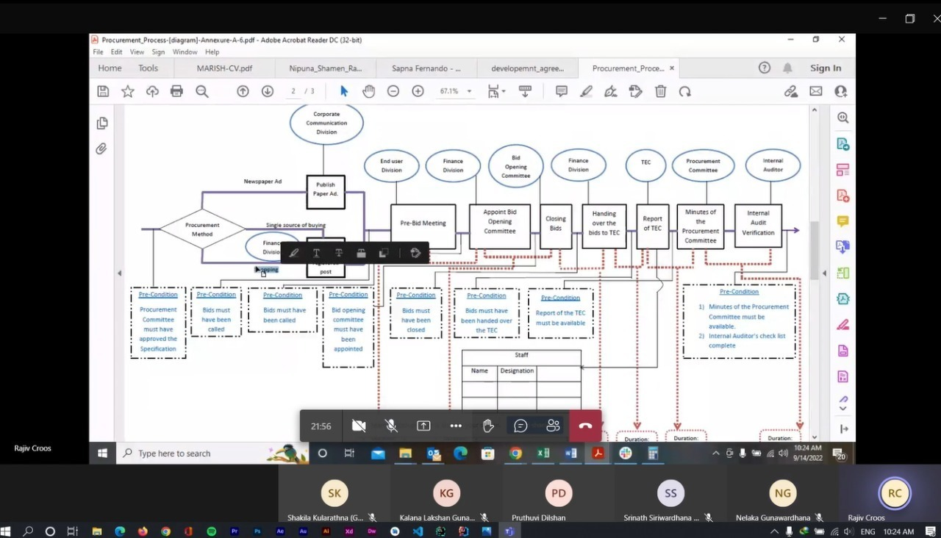
Evidence of Discussions with the Company

Slide 20

Thank you

